Slide 1

Module -3 Security and Risk Management August 2022 Unit 10 Seminar Preparation
Seminar 5: DR Solutions Design and Review

Slide 2
.
What are some of the main vendor lock-in issues the authors identify?
How would you mitigate them?
Customers who are dependent (i.e. locked-in) on a single cloud provider's technological implementation and unable to switch vendors in the future without high costs, legal restrictions, or technical incompatibilities are said to be experiencing vendor lock-in problems in cloud computing.
From the perspective of a software developer, the lock-in situation is further supported by the fact that users are exposed to any changes made by their providers because applications created for cloud platforms (such as Amazon EC2 and Microsoft Azure) cannot easily be migrated to other cloud platforms.
It is frequently suggested to develop standards tailored to the cloud in order to reduce vendor lock-in and ensure portability and interoperability. OASIS CAMP for PaaS and TOSCA for IaaS are two distinct examples of such cloud-specific standards. (Opara-Martins et al (2014) and Morrow et al (2021)).

Slide 3
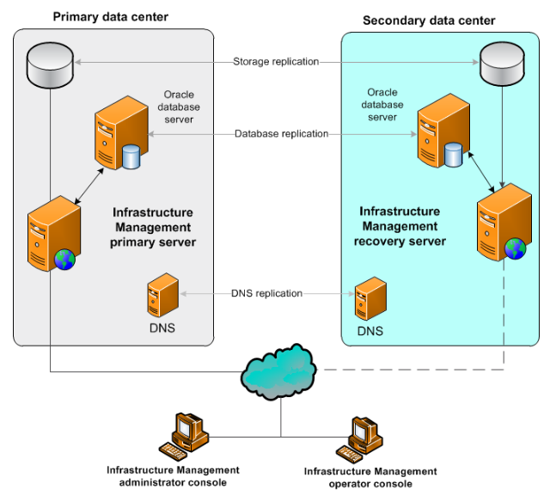
HIGH LEVEL DR Solution:
Create a high-level diagram of a DR solution for each of the following requirements. They should be created in PowerPoint, and you should include a basic description of each design

Slide 4
HIGH LEVEL DR Solution (Contd.):
Disaster occurrences put your workload's availability at risk, but you may reduce or eliminate these risks by adopting AWS Cloud services.
Choose a suitable DR plan by first analyzing the business needs for your workload.
Then, you may create an architecture that meets the recovery time and recovery point goals your organization requires by utilizing AWS services.

Slide 5
REFERENCES:
"Disaster Recovery (DR) Architecture on AWS, Part I: Strategies for Recovery in the Cloud" by Seth Eliot | on 05 APR 2021. https://aws.amazon.com/blogs/architecture/disaster-recovery-dr-architecture-on-aws-part-i-strategies-for-recovery-in-the-cloud/
Justice Opara-Martins, Reza Sahandi and Feng Tian "Critical analysis of vendor lock-in and its impact on cloud computing migration: a business perspective" Opara-Martins et al. Journal of Cloud Computing: Advances, Systems and Applications (2016) 5:4 DOI 10.1186/s13677-016-0054-z

